Slide 1
Vision West North Dakota
April 15, 2015 Gathering
Economic Diversification
Foundational to Economic Prosperity
DLN Consulting
03.25.15 Version

Slide 2

Economic Diversification
Foundational to Economic Prosperity
April 15, 2015
Notes:
Title Slide

Slide 3



Acknowledgements

Slide 4
Our Presentation Today
Part 1
Why this Matters and
How We Have Changed
Part 2
Implications of Energy Optimization
Part 3
Diversification Considerations

Slide 5
Why this Matters and
How We Have Changed
Prosperity – Resilience - Diversity
Pre-Bakken Reality
Current & Future Bakken Reality
Optimizing to the Energy
Eroding Economic Diversity
Questions & Discussion

Slide 6
Why Diversification Matters?
Smart
Intentional
Commitment
Resourced
Executed
End Game
Goal
Broadening & Deepening Prosperity
Economic
Diversification
Sustained
Prosperity
Increasing
Economic & Social Resilience
Increased Economic Diversity

Slide 7
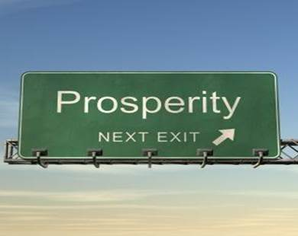
Sustained Prosperity
The End Game of Development
You Must Define Prosperity
The Economy is Doing Well
People are Doing Well
The Community is Prospering
Sustained?
Through business cycles and even generationally the community thrives.

Slide 8

The What and Why of Diversification
Multiple Ventures
Multiple Economic Sectors
Multiple Markets
Competitive Entrepreneurs
Illustrations…
  Trace, Kansas
  Bassett, North Carolina
  Northern Virginia
Remember… Don’t put all your eggs in one basket.

Slide 9
Economic Resilience
Economic Diversity increases Economic Resilience which enables Sustained Prosperity
Two Components of Resilience:
  Instantaneous Resilience
  Limiting immediate impacts.
  Dynamic Resilience
  Ability to reconstruct or recover.
Economic – Lost of an Industry
Social – Race Issues
Weather – Flood, Tornado, etc.

Slide 10
Personal Income Trends
Adjusted for inflation

Slide 11
Employment Trends

Slide 12
Population Trends

Slide 13
Three Trend Lines Indexed

Slide 14
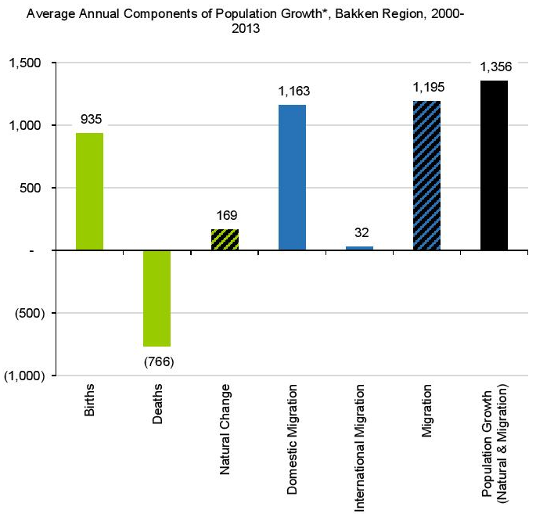
Last Decade Population Changes
The Census Bureau makes a minor statistical correction, called a “residual“ which is shown in the table above, but omitted from the figure.
Because of this correction, natural change plus net migration may not add to total population change in the figure.

Slide 15
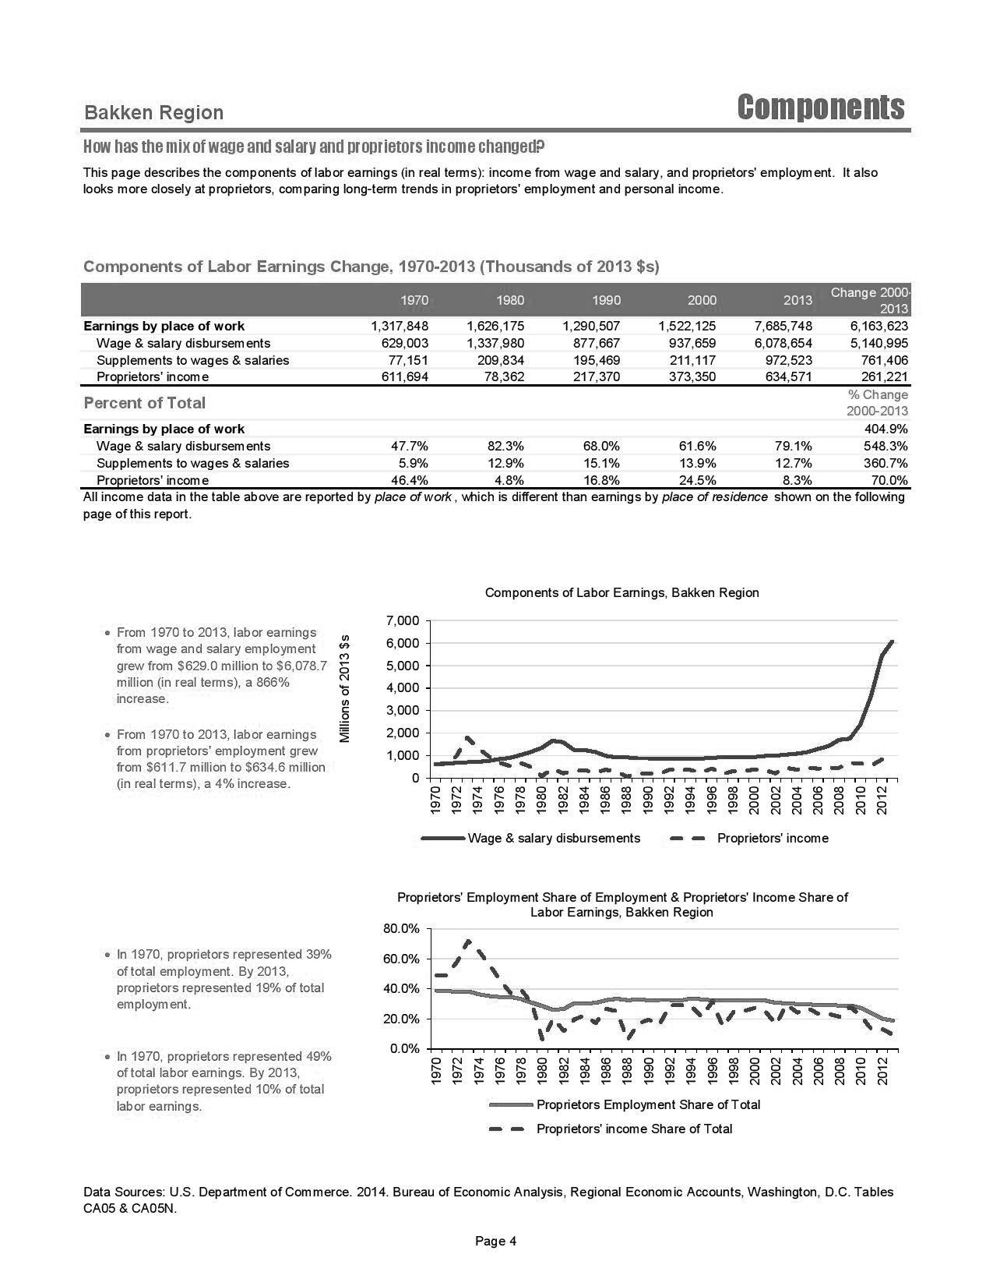
Components of Labor Earnings

Slide 16
Proprietor Trends

Slide 17
Economic Drivers - 2013
Personal Income 2013 (Millions) |  | Change 2001-2013 | 2013 Per Capita Values Benchmarked to the US
Mining | $2,561 | 273.2% | In the Bakken Region, Mining makes up more than 50 times the per capita income of the US
Retirees | $1,664 | 1.4%
Construction | $1,013 | 1200.2%
Transportation & Warehousing | $938 | 208.5%
Wholesale Trade | $643 | 569.4%
Government | $456 | 56.1%
Health Care | $304 | 92.5%
Retail Trade | $278 | 146.0%
Professional & Technical Services | $273 | 516.8%
Real Estate | $255 | 1473.7%
Per capita income for mining in the US represents about $527 while it represents over $26,000 in the Bakken Region.

Slide 18
Pre- & Post Bakken Comparison
Pre-Bakken Economy
Bakken Economy 2013
Top Sectors….
Retirees
Government
Manufacturing
Agriculture
Tourism
Relatively diversified economy and society.
Top Sectors…
Mining
Retirees
Construction
Transportation/Warehousing
Government
An economy optimizing to the energy sector.

Slide 19

Questions…

Slide 20
Implications of Energy Optimization
Energy Development Trends
Phases of Community Attitude
Scale – Pacing – Duration Implications
Dutch Disease – Crowing Out Effect
Questions & Discussion

Slide 21
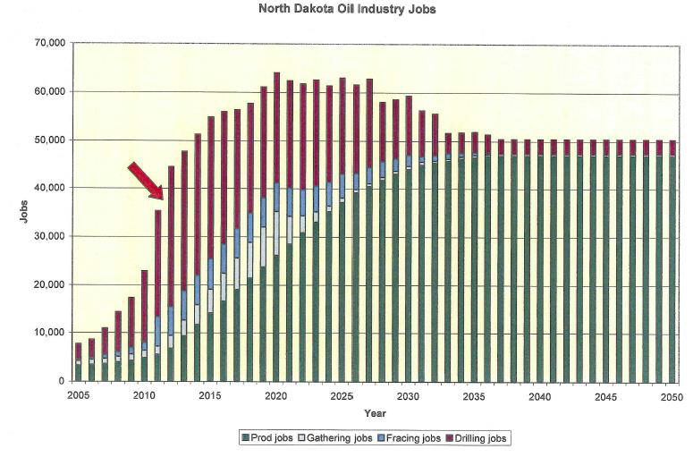
Long Duration Development

Slide 22
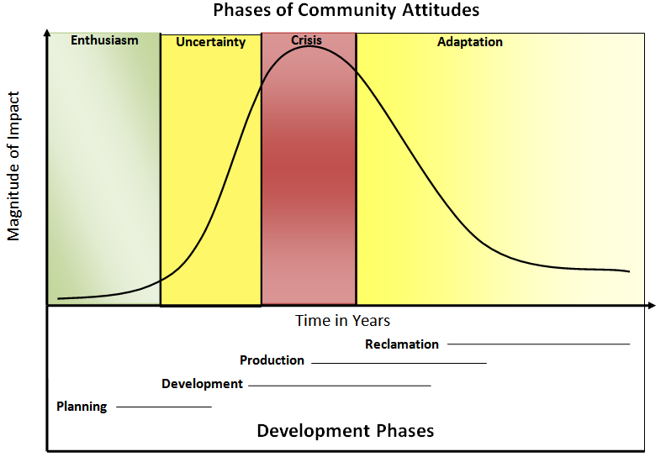
Phase of Community Attitude

Slide 23

Development Magnifiers
Scale
The larger the energy development the more the existing economy will optimize to the energy sector.
Duration
The longer the energy boom continues the greater the overall economy and society will become dependent upon the energy sector.
Pacing
The more rapid the development pacing the greater the impact on non-energy related economic activities.

Slide 24
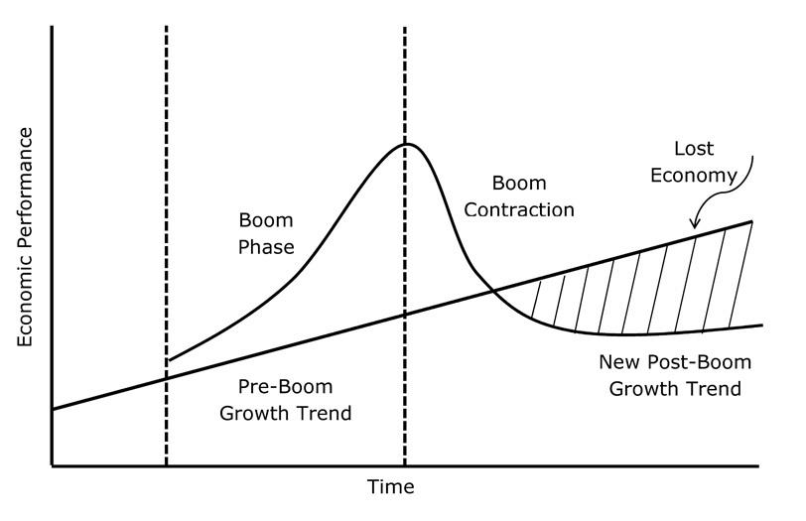
Crowing Out Effect

Slide 25
Questions…

Slide 26
Diversification Considerations
Three Core Strategies
Examples from the Field
Action Considerations
Resources
Questions & Discussion

Slide 27

Three Core Strategies
Capacity Building
Energy Sector Diversification
Diversifying Beyond Energy

Slide 28

Capacity Building
The energy boom is transforming the asset base of the region.
Human Talent
Venture Talent
Development Assets
Community Amenities
How can these assets be used to support economic diversification?

Slide 29

Energy Sector Diversification
Expertise
Value-Chain Development:
  Downstream Activities
  Upstream Activities
  Allied Activities
Attraction Opportunities:
  Resource Tied Industries
  Infrastructure Assets

Slide 30

Diversifying Beyond Energy
Two Strategies Related to Non-Energy Sectors of the Economy:
Sector Protection
Sector Development
Three Quick Stories:
Telluride Colorado
Kern County California
Minnesota’s Iron Range

Slide 31
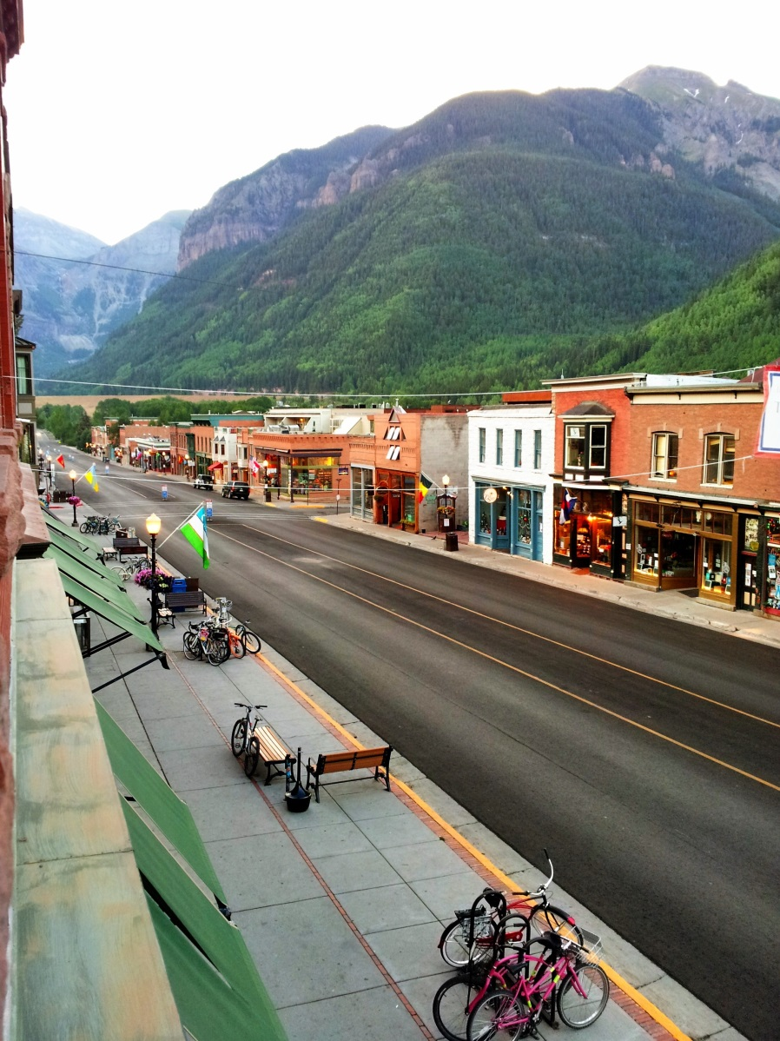
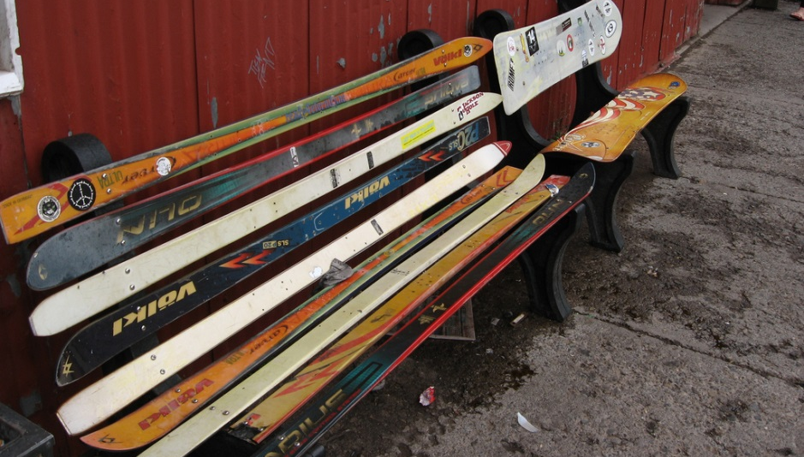
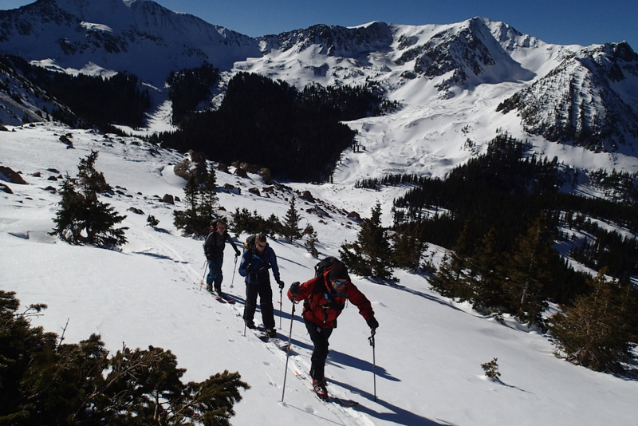
Telluride Colorado

Slide 32

Telluride Colorado
Southwestern Colorado
Very Isolated & Rural
Mining Boom & Bust
Renewed…
High End Tourism
Need for Diversification
Entrepreneurship Strategy

Slide 33

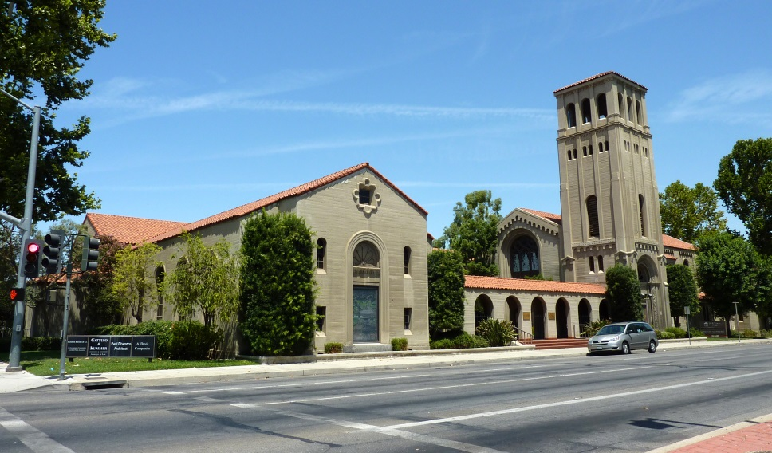
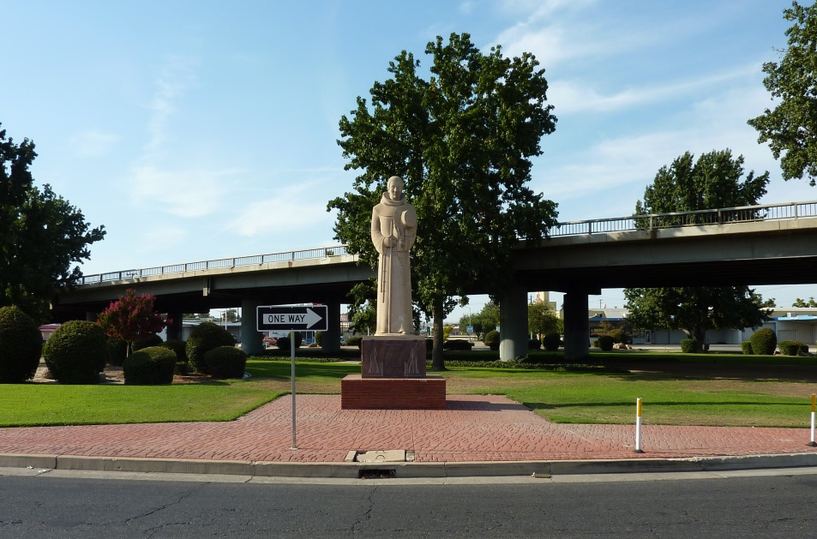
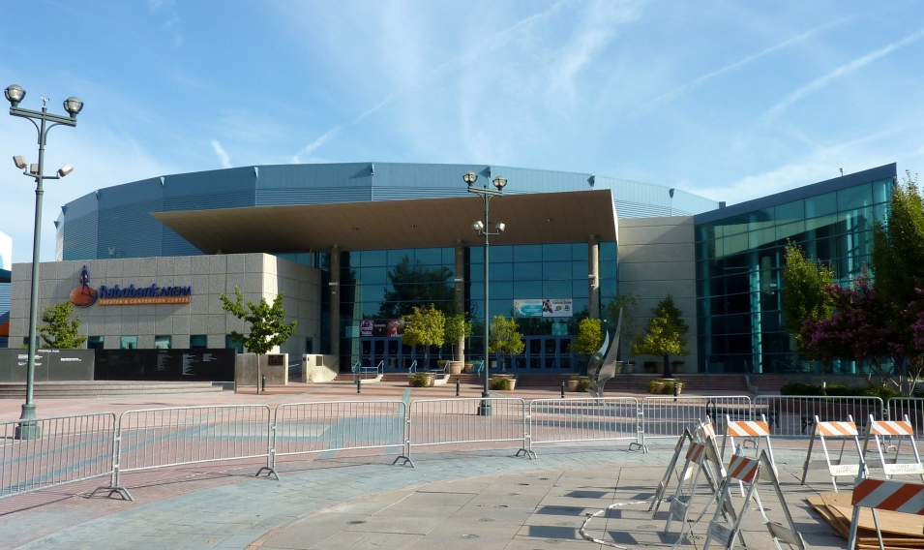
Kern County California

Slide 34


Kern County California
Legacy Oil and Gas
Current Energy Production
Rooted Energy Related Service Companies
Contributes to a Diversified Economy…
  Agriculture
  Commuters
  New Residents
  Regional Hub

Slide 35
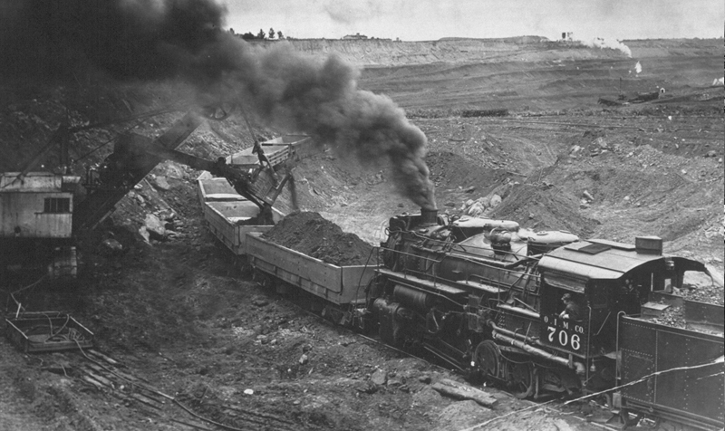
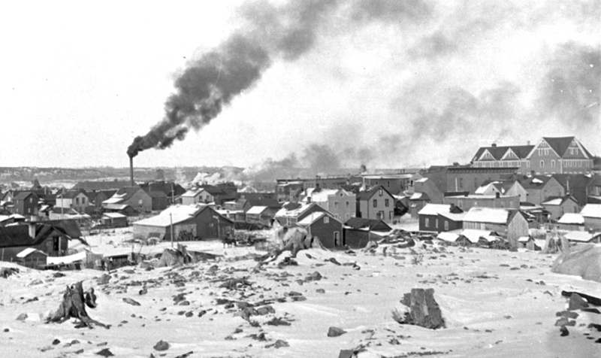
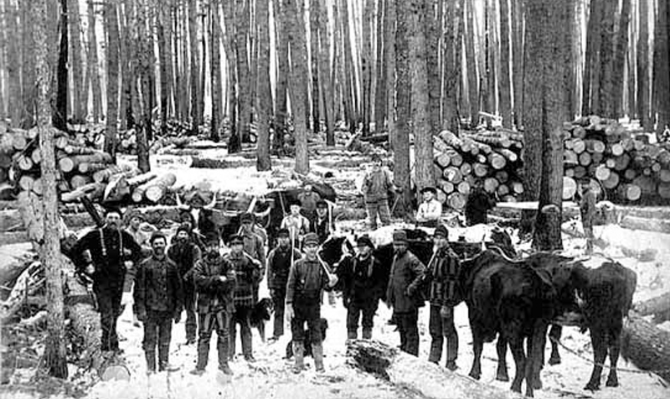
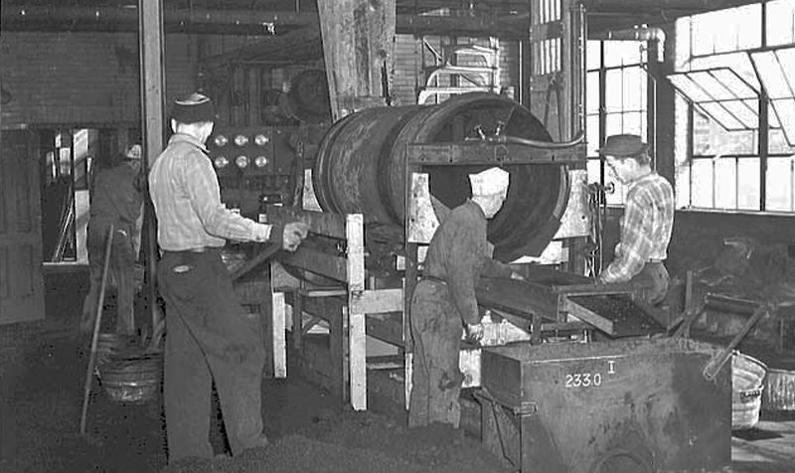
Minnesota’s Iron Range

Slide 36


Minnesota’s Iron Range
Historic Iron Ore Mining
1941 – 74 Years Old
IRRRB - Governor Harold Stassen
Iron Ore to Taconite - $200 mil
Douglas J Johnson Economic Protection Fund
  Community Development
  Economic Development - $3.1 billion
  Workforce Development
  Mine Land Reclamation
  Giants Ridge

Slide 37

Action Considerations…
Challenge:
We know it is important.
We recommend it.
Yet we struggle with it.
Solution?
Commitment
Clear Outcomes
Smart System & Approach
Execution

Slide 38
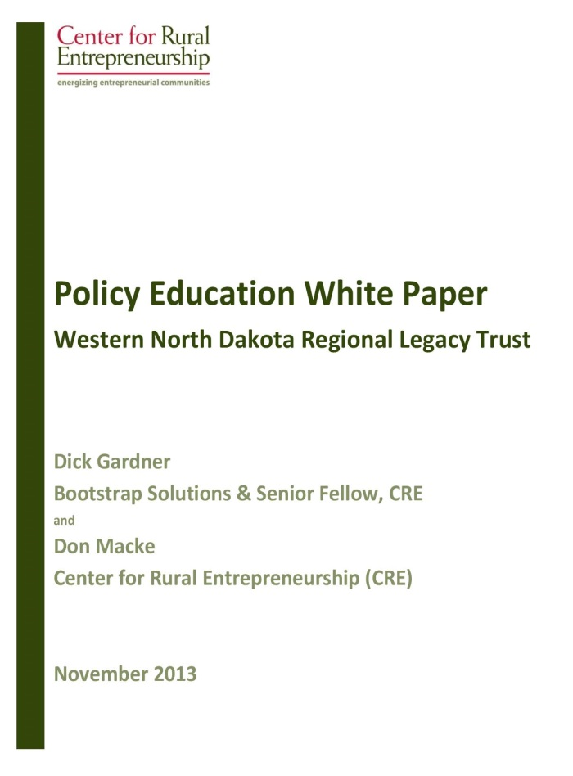
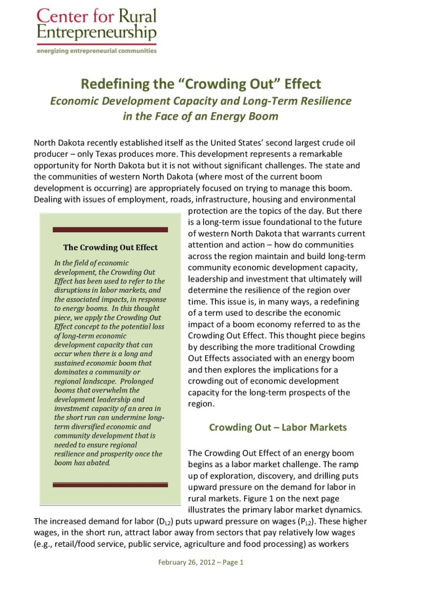

Three Resources

Slide 39

Regional Legacy Fund
10-Year Value of Production
$218 Billion
State Share of Taxes
80% or $17.5 Billion
Local Share of Taxes = 20% or $4.4 Bil.
Local Development Aid = $2.8 Billion
Regional Trust Fund:
Value in Year 10 = $1.55 Billion
Annual Payout Capacity = $775 Million

Slide 40
Questions…

Slide 41

Resources
We will be working with DLN and Vision West ND to provide you…
Recorded Webinar
Power Points
Background Research
Iron Range Webinar
2012 White Paper
2013 White Paper
Crowding Out Effect Paper

Slide 42

Questions & Discussion
Don Macke
don@e2mail.org
www.energizingentrepreneurs.org

